Slide 1
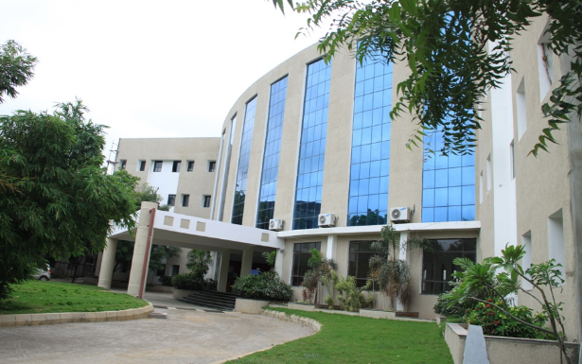
MOBILE AIR POLLUTION MONITORING
AND BUS TRACKING
Presented by
1. K. MANOHAR REDDY : 19QM1A0431
2. N.V.V.RAMANA REDDY : 19QM1A0446
3. P. SAI KARTHIKA : 19QM1A0455
4. R. DEEPAK REDDY : 19QM1A0456
Under the Guidance of
Mr. Vijaya Bhasker Reddy M. Tech (Ph. D)
Assistant Professor

Slide 2
CONTENTS
Introduction
Literature Study
Problem Statement
Problem Scoping
Aim/Objective
Methodology
7.Tools required
8.Working principle
9.Results and discussion
10.Conclusion
11.Future work
12.Reference

Slide 3
Introduction
The primary aim of this project is to track the bus location and monitor air pollution levels in the environment through a mobile application.
When there is a bus failure on an ongoing journey, the passengers go into a dilemma whether to wait there for help to arrive or to move by private vehicle.
Nowadays, the increase in harmful gases in the atmosphere is causing damage to human life.
Through an android application, we can track the current status of the bus, monitoring the air pollution levels and updating the status of those to the nearest corresponding departments.

Slide 4
Literature Study
S.NO | TITLE OF THE PAPER | AUTHORS | CONFERENCE/ JOURNAL NAME | YEAR | PROBLEM ADDRESS
1. | A Low Cost Outdoor Air Pollution Monitoring Device with Power Controlled Built-In PM Sensor | Das, Payali and Ghosh, Sushmita and Chatterjee, Shouri and De, Swades | IEEE Sensors Journal, vol. 22, no. 13, pp. 13682-13695 | 2022 | This article presents the design of a low cost, innovative Air Pollution Monitoring Device (APMD) along with the evaluation of its advanced features. An on-board Particulate Matter (PM) sensor is designed to measure PM _{2.5} and PM ₁₀ .
2. | IoT Bus Monitoring System via Mobile Application | Hakeem, Muhammad Fareez Mohd Ainul and Sulaiman | IEEE International Conference on Automatic Control and Intelligent Systems (I2CACIS), 2022, pp. 125-130 | 2022 | This paper presents a simple Internet of Things (IoT) prototype for users to view or for authorities to monitor the bus activity via a mobile application on the available bus seats, bus schedule, and bus activities.
3. | Rapid detection of high-emitting vehicles by on-road remote sensing technology improves urban air quality | Huang, Yuhan and Lee, Casey KC and Yam, Yat-Shing and Mok | Science advances | 2020 | Here, we report the use of on-road remote sensing (RS) technology for fast, accurate, and cost-effective identification of high-emitting vehicles as an enforcement program for improving urban air quality.
4. | An Adaptive Communication Model for Android Bus Tracking App | Baichoo Bibi and Chiniah, Aatish | IEEE, 2nd Global Conference for Advancement in Technology (GCAT), 2021, pp. 1-6 | 2021 | In order to have an efficient Android Bus Tracking App, it needs to be able to communicate with bus device that could be in any location at any given time.

Slide 5
Literature Study
S.NO | TITLE OF THE PAPER | AUTHORS | CONFERENCE/ JOURNAL NAME | YEAR | PROBLEM ADDRESS
5. | Air pollution monitoring and prediction using IoT | Ayele, Temesegan Walelign and Mehta, Rutvik | IEEE, Sixth International Conference on Parallel, Distributed and Grid Computing (PDGC), 2020, pp. 57-60 | 2018 | In this work an IoT based air pollution monitoring and prediction system is proposed.
6. | On modeling air pollution detection with internet of vehicles | Shakhov, Vladimir and Sokolova, Olga | IEEE, 15th International Asian School-Seminar Optimization Problems of Complex Systems (OPCS), 2019, pp. 183-186 | 2021 | In the paper we consider a monitoring system, which sensors installed on vehicles.
7. | Android application based smart bus transportation system for pandemic situations | Krishnan, R Santhana and Manikandan, S and Raj | IEEE, Third International Conference on Intelligent Communication Technologies and Virtual Mobile Networks (ICICV), 2021, pp. 938-942 | 2021 | In order to provide additional safety to the passengers the temperature of the passengers is monitored and intimated to the bus in change before they are permitted into the bus.
8. | Bus Tracking App for Universities Transportation | Mohammed, Siti Asma | TURCOMAT | 2021 | The main objectives of developing this application are to inform users regarding the current bus location and estimated arrival time.

Slide 6
Literature Study
S.NO | TITLE OF THE PAPER | AUTHORS | CONFERENCE/ JOURNAL NAME | YEAR | PROBLEM ADDRESS
9. | Smart School Bus Tracking: Requirements and Design of an IoT based School Bus Tracking System | Gull, Hina and Aljohar, Dalal and Alutaibi, Reem and Alqahtani, Dalia and Alarfaj, Muna and Alqahtani, Rahaf | IEEE, 5th International Conference on Trends in Electronics and Informatics (ICOEI), 2021, pp. 388-394 | 2021 | Proposed IoT based Bus Tracking System, will introduce a tracking website and an android application for the school admin, drivers of the bus and the parents. Proposed system will provide the admin with the charge of adding new bus driver and new student to the driver.
10. | Design of bus tracking and fuel monitoring system | Vigneshwaran, S and Nithya, B and Raghul, K and Nivas, B and Kishore, VM | IEEE, 2017 International Conference on Communication, Control, Computing and Electronics Engineering (ICCCCEE), 2017, pp. 1-5 | 2020 | The present age requires the data time to time. The utilization of innovation have been expanding step by step. So we are making arrangements for the mix of present innovation with the prerequisite of data transmission.
11. | RFID based smart transportation system with android application | Akter, Rezowana and Khandaker, Md Jahid Hasan and Ahmed, Shakil and Mugdho, Muhtasim Munem and Haque, AKM Bahalu | IEEE, 2nd International Conference on Innovative Mechanisms for Industry Applications (ICIMIA), 2020, pp. 614-619 | 2020 | Our system uses RFID, GPS, and an android application for passenger management and real-time tracking features for offering a satisfying bus fare calculation.
12. | Bus arrival time prediction based on LSTM and spatial-temporal feature vector | Liu, Hongjie and Xu, Hongzhe and Yan, Yu and Cai, Zaishang and Sun, Tianxu and Li, Wen | IEEE Access, vol. 8, pp. 11917-11929 | 2020 | The factors affecting urban traffic conditions are complex and changeable. As the predicted distance increases, the difficulty of traffic prediction becomes more difficult.

Slide 7
Literature Study
S.NO | TITLE OF THE PAPER | AUTHORS | CONFERENCE/ JOURNAL NAME | YEAR | PROBLEM ADDRESS
13. | Graph learning techniques using structured data for IoT air pollution monitoring platforms | Ferrer-Cid, Pau and Barcelo-Ordinas, Jose M and Garcia-Vidal, Jorge | IEEE Internet of Things Journal, vol. 8, no. 17, pp. 13652-13663 | 2021 | However, recent developments in low-cost sensor technology and wireless communication systems like IoT provide an opportunity to use arrayed sensor networks to measure air pollution, in real time, at a large number of locations.
14. | Air Pollution Monitoring System by using Arduino IDE | Perumal, B and Deny, J and Alekhya, K and Maneesha, V and Vaishnavi, M | IEEE, 2nd International Conference on Electronics and Sustainable Communication Systems (ICESC), Coimbatore, India, 2021, pp. 797-802 | 2021 | Due to the rapid increase in industrial activity over the years, there is a much greater need for monitoring the air quality. This project proposes a framework for tracking air pollution. The proposed model is regulated by an Arduino mini control.
15. | Air quality prediction in smart cities using machine learning technologies based on sensor data: a review | Iskandaryan, Ditsuhi and Ramos, Francisco and Trilles, Sergio | MDPI | 2020 | This paper covers the revision of the studies related to air pollution prediction using machine learning algorithms based on sensor data in the context of smart cities
16. | Real-time air pollution monitoring with sensors on city bus | Kaivonen, Sami and Ngai, Edith C-H | Elsevier | 2020 | This paper presents an experimental study on real-time air pollution monitoring using wireless sensors on public transport vehicles

Slide 8
Problem Statement
The difficulties faced by people when a bus fails or one fails to board the bus on time lead to confusion among the people. Also air pollution is one of the major environmental issues that cannot be ignored. Inhaling pollutants for a long time causes damage to human health.

Slide 9







Problem scoping
User’s
Travelers
Pollution control board
End user
People who lives in urban areas
Educational Institutions
Existing solution
Both bus tracking &air pollution monitoring are already in existence, but in separate domain
MOBILE AIR POLLUTION MONITORING
AND BUS TRACKING
Stake holders
Pollution control board of Telangana
Road Transportation corporation
Our solution
Here, both the specified applications will be existed in same domain
Importance to solve
Time Management
To protect environment
Health issues caused due to pollution

Slide 10
Why and Who needs this
Imagine being able to track the location of your bus in real-time. With a bus tracking system, you can do just that! A bus tracking system can help our organization improve transportation efficiency and optimize routing. It can also help you track the whereabouts of buses and passengers in real-time, giving you complete visibility into your bus operations.
The different areas have different levels of air quality at different times it is important for us to monitor what is happening. That way we can identify trouble spots and ensure that we are taking the right steps.
Our application will be used by students, faculty, travellers, elderly people and pollution control board etc.

Slide 11
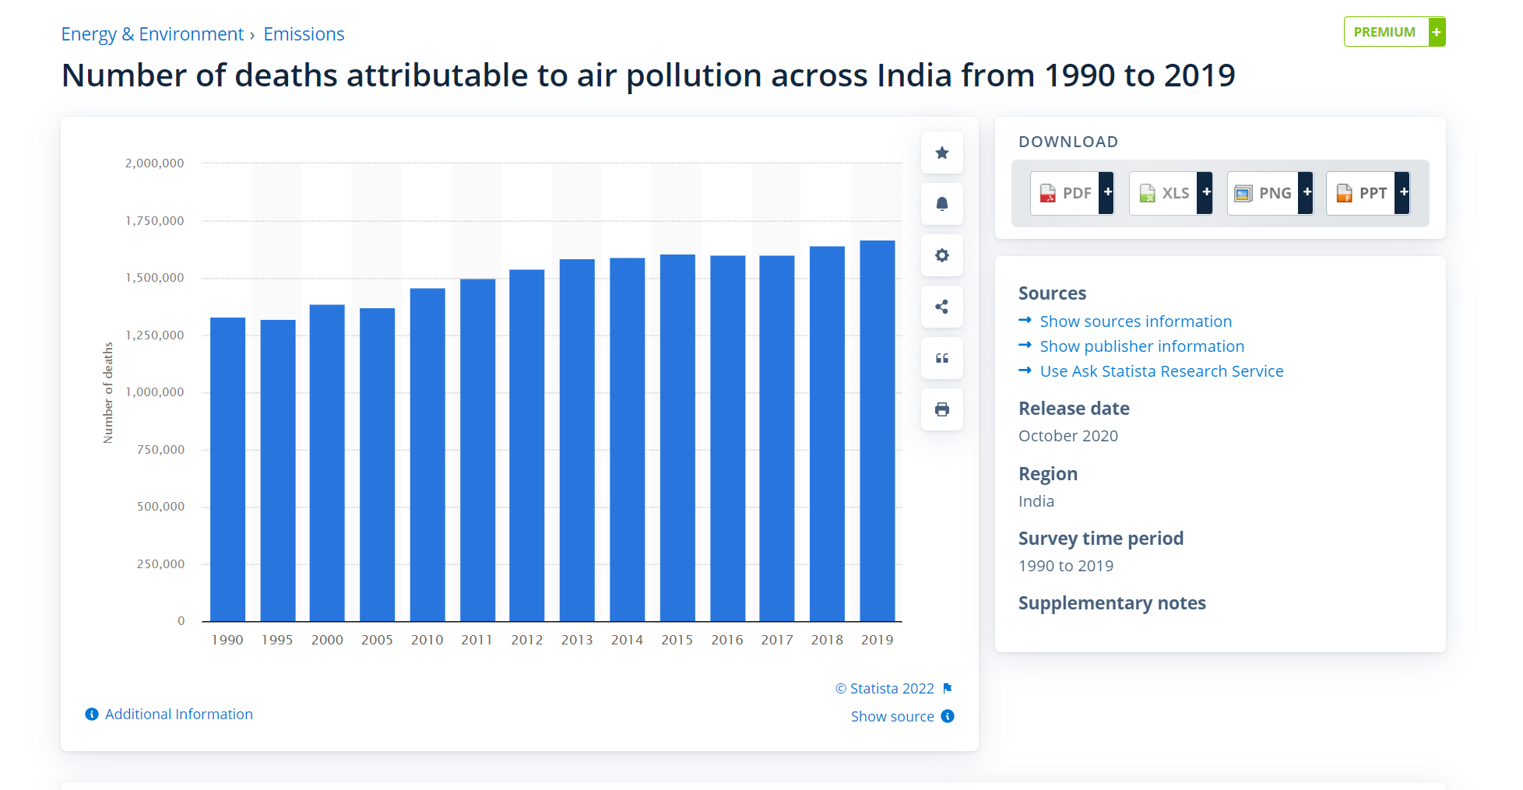
Past Analysis
No of deaths due to Air Pollution(1990-2019)

Slide 12
Aim/Objective
Aim: The is to build an "Android application" which will help us track the bus locations and monitor the air pollution levels in the environment through a mobile application.
Objective: To provide the information and location of bus and amount of pollution during the journey of various places to the stake holders for taking care and prior precautions.

Slide 13
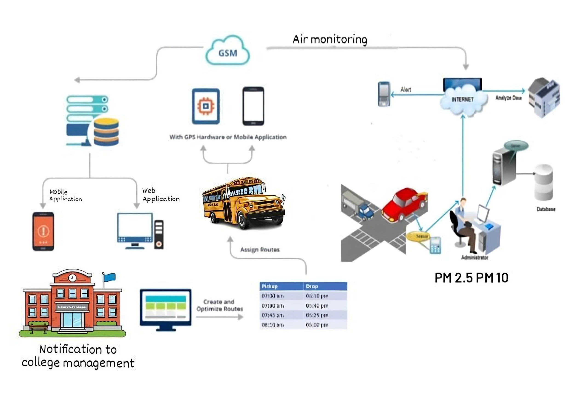
Methodology

Slide 14
Tools Required
Hardware components
Node MCU-ESP 8266
Particular matter sensor-SDS011
GPS module-U-BLOX NEO-6M-0-001
GSM module
DHT-11
Software components
Arduino IDE
ThingSpeak

Slide 15
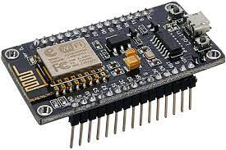
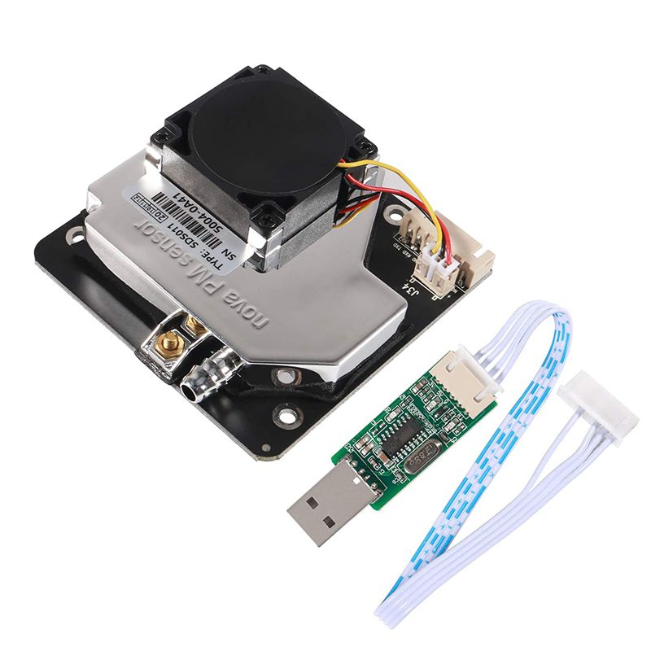
Hardware Components
Node 8266MCU-ESP
NodeMCU is an open source platform based on ESP8266 which can connect objects and let data transfer using the Wi-Fi protocol. In addition, by providing some of the most important features of microcontrollers such as GPIO, PWM, ADC, and etc, it can solve many of the project's needs alone.
Particular matter sensor-SDS011
Nova Fitness SDS011 is a professional laser dust sensor. Fan mounted on sensor automatically sucks air. Sensor uses laser light scattering principle to measure value of dust particles suspended in the air. Sensor provides high precision and reliable readings of PM2. 5 and PM10 values.

Slide 16
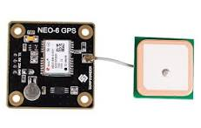
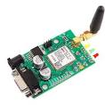
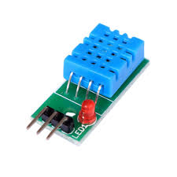
Hardware components
GPS module-U-BLOX NEO-6M-0-001
GPS modules contain tiny processors and antennas that directly receive data sent by satellites through dedicated RF frequencies. From there, it'll receive timestamp from each visible satellites, along with other pieces of data.
GSM module
A GSM modem or GSM module is a device that uses GSM mobile telephone technology to provide a wireless data link to a network. GSM modems are used in mobile telephones and other equipment that communicates with mobile telephone networks. They use SIMs to identify their device to the network.
DHT-11
The DHT-11 Digital Temperature And Humidity Sensor is a basic, ultra low-cost digital temperature and humidity sensor. It uses a capacitive humidity sensor and a thermistor to measure the surrounding air and spits out a digital signal on the data pin (no analog input pins needed).

Slide 17
Software Components
The Arduino Integrated Development Environment - or Arduino Software (IDE) - contains a text editor for writing code, a message area, a text console, a toolbar with buttons for common functions and a series of menus. It connects to the Arduino hardware to upload programs and communicate with them.
Arduino IDE -
ThingSpeak -
ThingSpeak™ is an IoT analytics platform service that allows you to aggregate, visualize and analyze live data streams in the cloud. ThingSpeak provides instant visualizations of data posted by your devices to ThingSpeak.

Slide 18
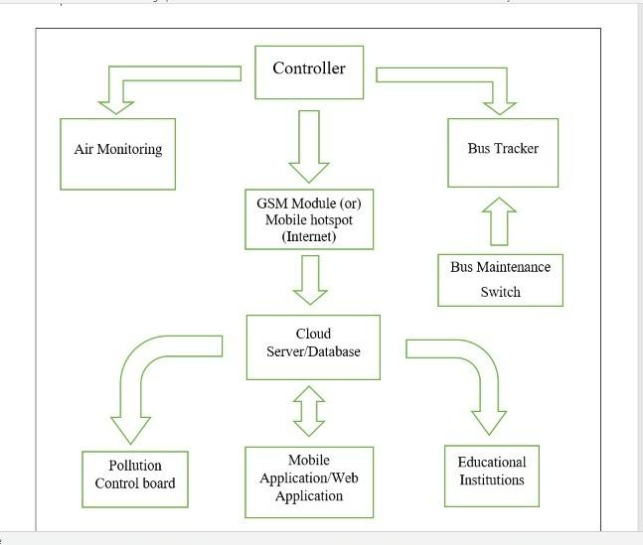
Working Principle
Block diagram of Mobile Air Pollution Monitoring and Bus Tracking System

Slide 19
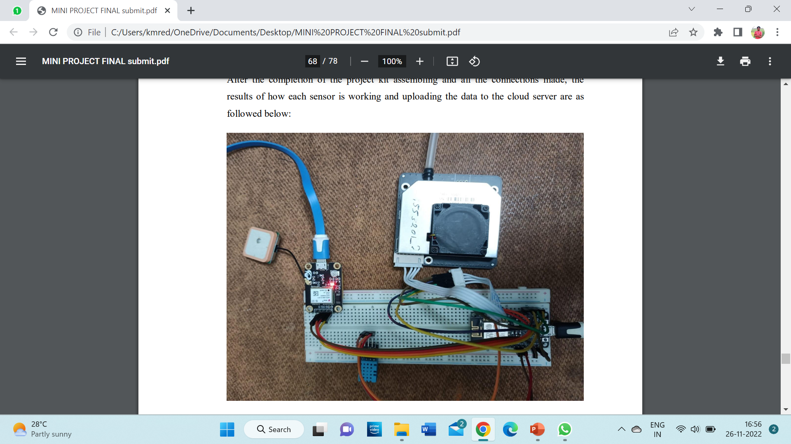
Results and Discussions
Circuit Connections
After the completion of the project kit assembling and all the connections made, the results of how each sensor is working and uploading the data to the cloud server are as followed below

Slide 20
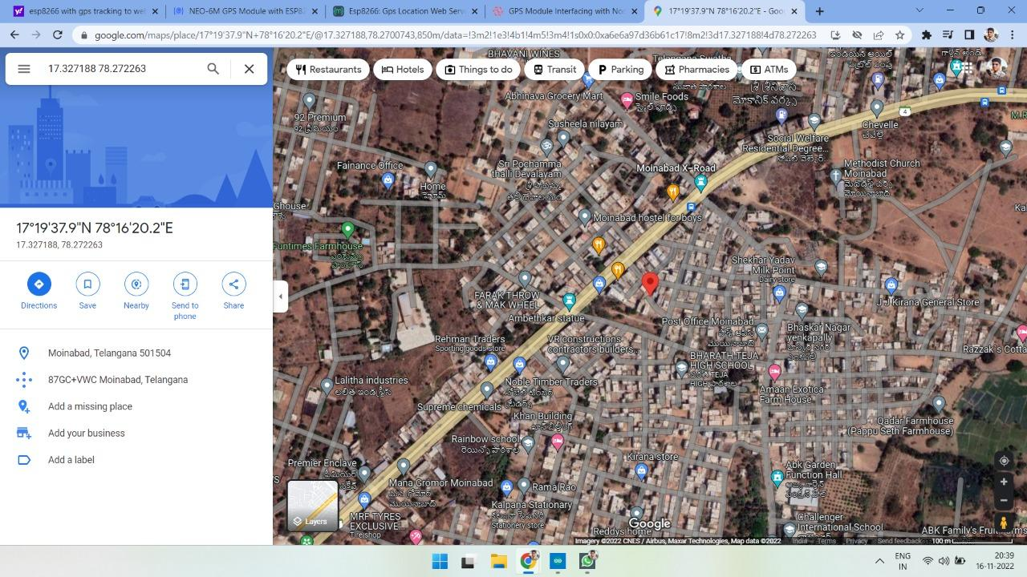
Results and Discussions

Slide 21
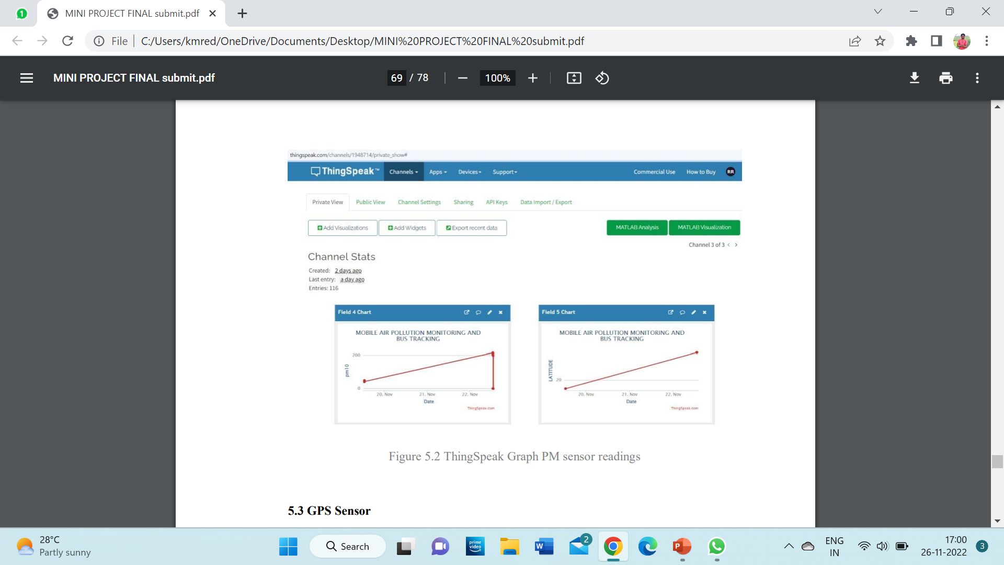
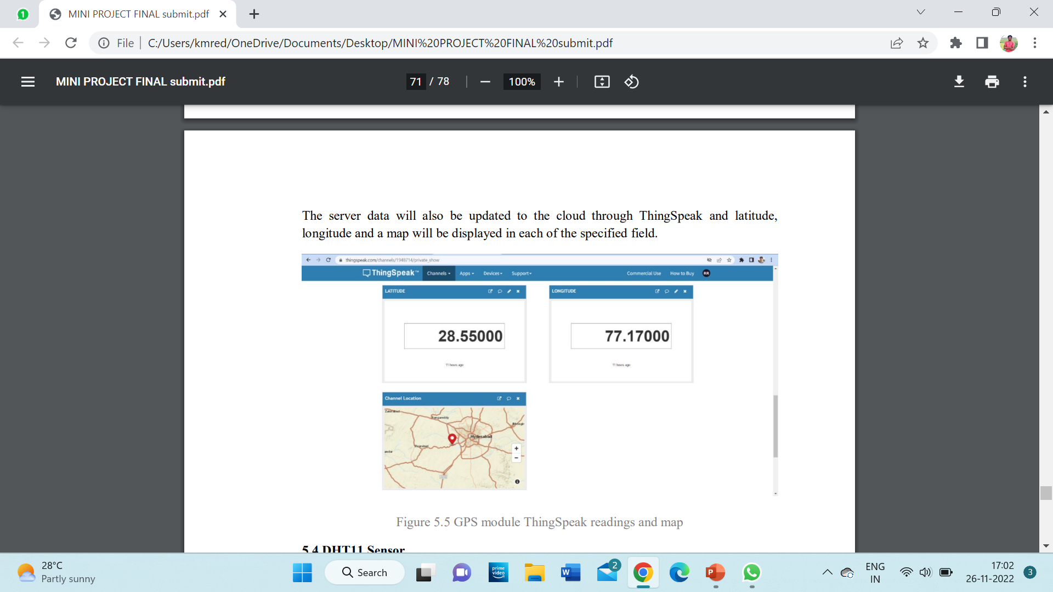
Results and Discussions
ThingSpeak Graph PM sensor readings
GPS module ThingSpeak readings and map

Slide 22
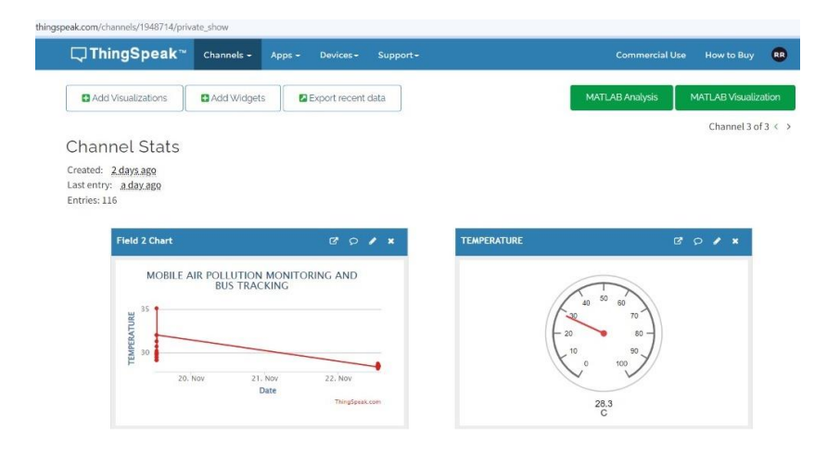
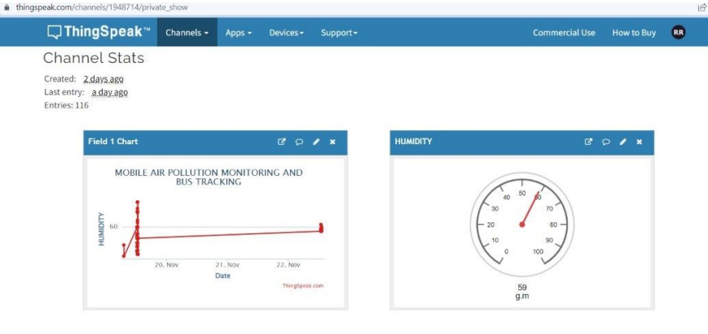
Results and Discussions
ThingSpeak Graph of Temperature and Humidity

Slide 23
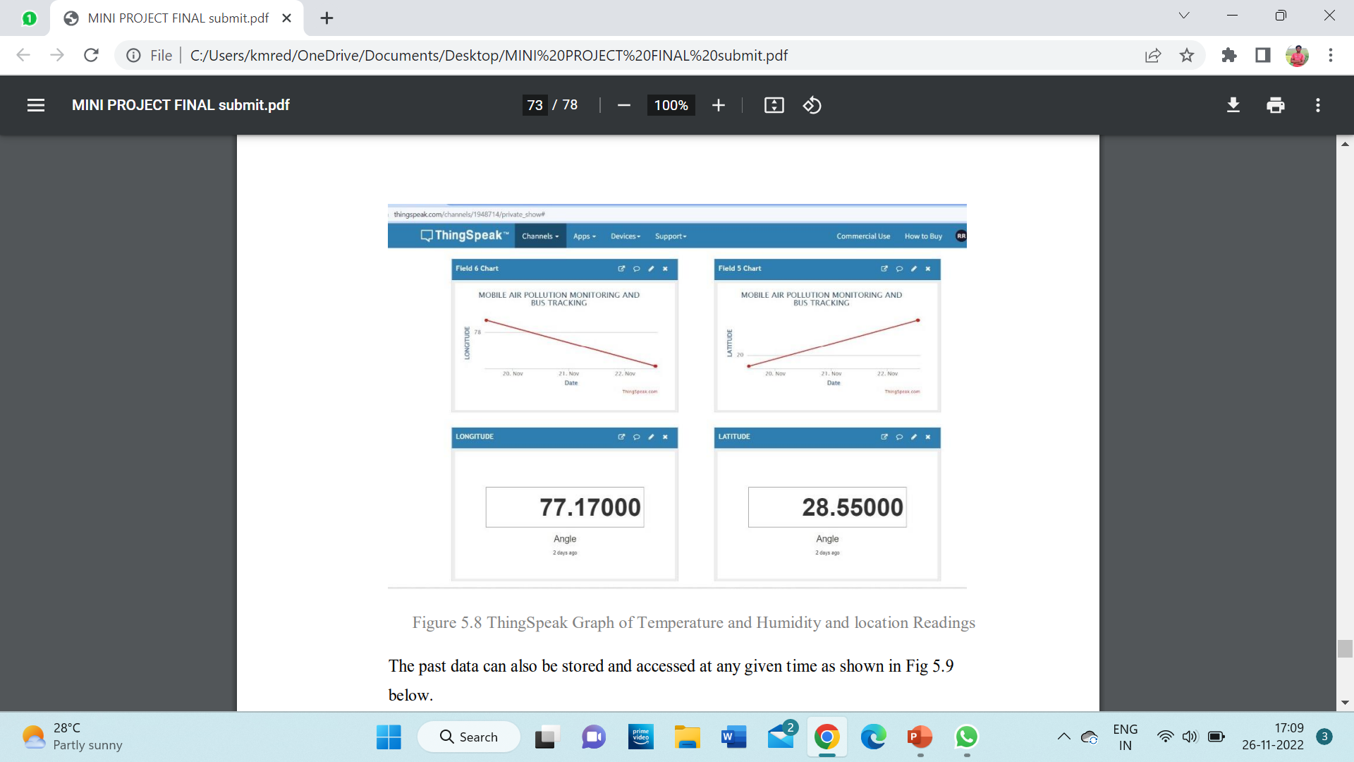
Results and Discussions
ThingSpeak Graph of location Readings

Slide 24
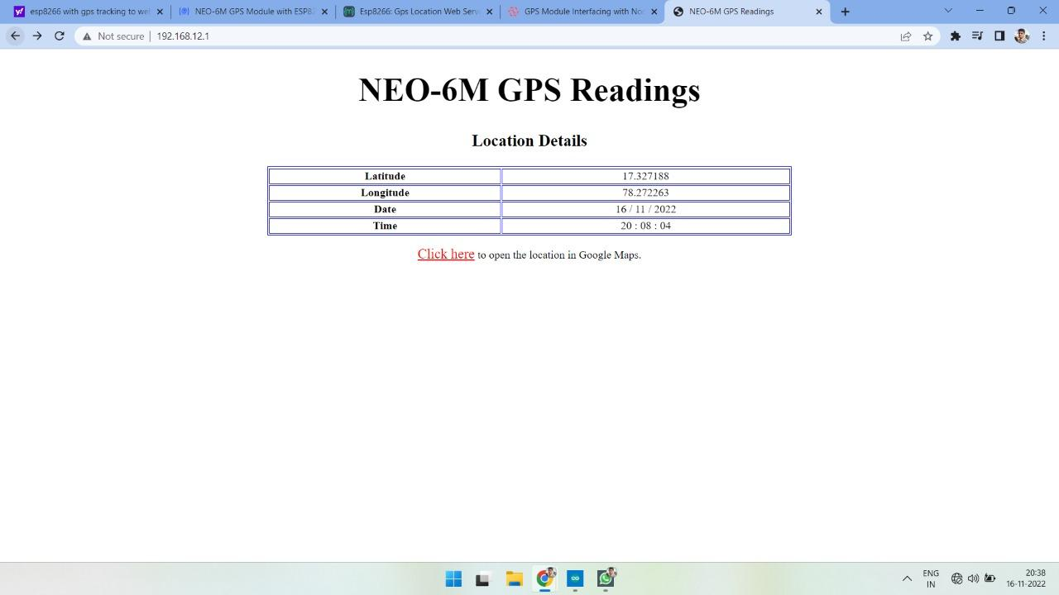
Results and Discussions
GPS Readings in Server

Slide 25
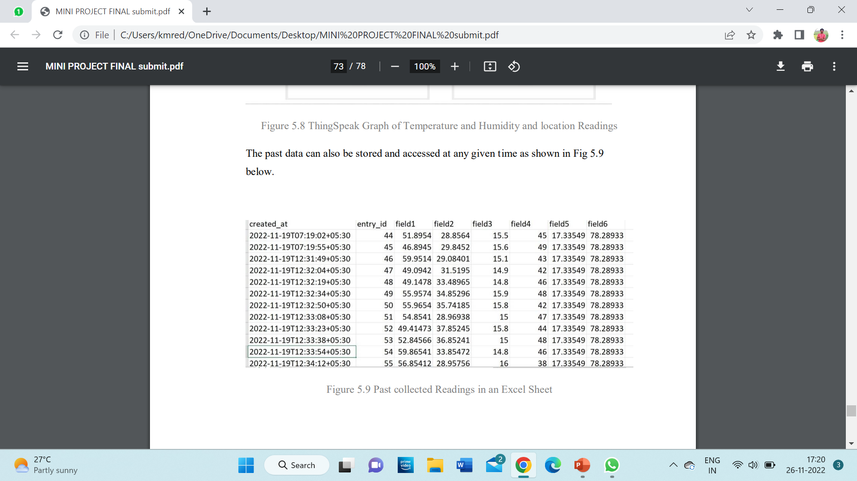
Results and Discussions
Past collected Readings in an Excel Sheet

Slide 26
Conclusion
The project titled “MOBILE AIR POLLUTION MONITORING AND BUS TRACKING” is a model for bus tracking unit with the help of GPS receivers and GSM modem and it is better scheduling or route planning can enable you handle larger jobs loads within a particular time. Bus tracking both in case of personal as well as business purpose improves safety and security, communication medium, performance monitoring and increases productivity.
As well as the air pollution monitoring will be done parallelly, the different areas have different levels of air quality at different times it is important for us to monitor what is happening. In this way we can identify trouble spots and ensure that we are taking the right steps. So, in the coming year, it is going to play a major role in our day-to-day living. We have completed the project as per the requirements of our project.

Slide 27
Future work
1. The proposed system can be connected to a GSM module and when the air pollution levels cross a certain threshold, it can immediately alert the local pollution board and other concerned parties.
2. We can reduce the size of the kit and increase accuracy up to 3m by using more standard GPS receivers.
3.The proposed system can be modified and can also be upgraded To make more effective and real time we can add air purifier to the existing model which might also be bit complex.
4.The proposed system can be upgraded to collection of data like carbon dioxide, sulfur oxide, nitrogen oxide and so on so that we can accurately judge the air pollutant levels in the air at the specific location.

Slide 28
References
[1] [P. Das, S. Ghosh, S. Chatterjee and S. De, "A Low Cost Outdoor Air Pollution Monitoring Device With Power Controlled Built-In PM Sensor," in IEEE Sensors Journal, vol. 22, no. 13, pp. 13682-13695, 1 July1, 2022, doi: 10.1109/JSEN.2022.3175821.
[2] M. F. M. A. Hakeem, N. A. Sulaiman, M. Kassim and N. M. Isa, "IoT Bus Monitoring System via Mobile Application," 2022 IEEE International Conference on Automatic Control and Intelligent Systems (I2CACIS), 2022, pp. 125-130, doi: 10.1109/I2CACIS54679.2022.9815268.
[3] B. B. Humaïra and A. Chiniah, "An Adaptive Communication Model for Android Bus Tracking App," 2021 2nd Global Conference for Advancement in Technology (GCAT), 2021, pp. 1-6, doi: 10.1109/GCAT52182.2021.9587657.
[4] T. W. Ayele and R. Mehta, "Air pollution monitoring and prediction using IoT," 2018 Second International Conference on Inventive Communication and Computational Technologies (ICICCT), 2018, pp. 1741-1745, doi: 10.1109/ICICCT.2018.8473272.
5] V. Shakhov and O. Sokolova, "On Modeling Air Pollution Detection With Internet of Vehicles," 2021 15th International Conference on Ubiquitous Information Management and Communication (IMCOM), 2021, pp. 1-3, doi: 10.1109/IMCOM51814.2021.9377350.
[6] R. S. Krishnan, S. Manikandan, J. R. F. Raj, K. L. Narayanan and Y. H. Robinson, "Android Application based Smart Bus Transportation System for Pandemic Situations," 2021 Third International Conference on Intelligent Communication Technologies and Virtual Mobile Networks (ICICV), 2021, pp. 938-942, doi: 10.1109/ICICV50876.2021.9388625.

Slide 29
References
[7] H. Gull, D. Aljohar, R. Alutaibi, D. Alqahtani, M. Alarfaj and R. Alqahtani, "Smart School Bus Tracking: Requirements and Design of an IoT based School Bus Tracking System," 2021 5th International Conference on Trends in Electronics and Informatics (ICOEI), 2021, pp. 388-394, doi: 10.1109/ICOEI51242.2021.9452818.
[8] S. A. E. Yosif, M. M. Abdelwahab, M. Abd Elrahman ALagab and F. Muhammad, "Design of bus tracking and fuel monitoring system," 2017 International Conference on Communication, Control, Computing and Electronics Engineering (ICCCCEE), 2017, pp. 1-5, doi: 10.1109/ICCCCEE.2017.7867679.
[9] R. Akter, M. J. H. Khandaker, S. Ahmed, M. M. Mugdho and A. K. M. B. Haque, "RFID based Smart Transportation System with Android Application," 2020 2nd International Conference on Innovative Mechanisms for Industry Applications (ICIMIA), 2020, pp. 614-619, doi: 10.1109/ICIMIA48430.2020.9074869.
[10] H. Liu, H. Xu, Y. Yan, Z. Cai, T. Sun and W. Li, "Bus Arrival Time Prediction Based on LSTM and Spatial-Temporal Feature Vector," in IEEE Access, vol. 8, pp. 11917-11929, 2020, doi: 10.1109/ACCESS.2020.2965094.
[11] P. Ferrer-Cid, J. M. Barcelo-Ordinas and J. Garcia-Vidal, "Graph Learning Techniques Using Structured Data for IoT Air Pollution Monitoring Platforms," in IEEE Internet of Things Journal, vol. 8, no. 17, pp. 13652-13663, 1 Sept.1, 2021, doi: 10.1109/JIOT.2021.3067717.

Slide 30
References
[12] B. Perumal, J. Deny, K. Alekhya, V. Maneesha and M. Vaishnavi, "Air Pollution Monitoring System by using Arduino IDE," 2021 Second International Conference on Electronics and Sustainable Communication Systems (ICESC), 2021, pp. 797-802, doi: 10.1109/ICESC51422.2021.9533007.
[13] K. Ammar, M. Jalmoud, A. Boushehri and K. Fakhro, "A Real-time School Bus Tracking and Monitoring System," 2019 IEEE 10th Annual Information Technology, Electronics and Mobile Communication Conference (IEMCON), 2019, pp. 0654-0660, doi: 10.1109/IEMCON.2019.8936199.
[14] S. Akter, T. Islam, R. F. Olanrewaju and A. A. Binyamin, "A Cloud-Based Bus Tracking System Based on Internet-of-Things Technology," 2019 7th International Conference on Mechatronics Engineering (ICOM), 2019, pp. 1-5, doi: 10.1109/ICOM47790.2019.8952037.
[15] M. A. Hafiizh Nur, S. Hadiyoso, F. B. Belladina, D. N. Ramadan and I. Wijayanto, "Tracking, Arrival Time Estimator, and Passenger Information System on Bus Rapid Transit (BRT)," 2020 8th International Conference on Information and Communication Technology (ICoICT), 2020, pp. 1-4, doi: 10.1109/ICoICT49345.2020.9166375.
[16] K. Premkumar, P. K., P. J., P. D. and P. P., "College Bus Tracking and Notification System," 2020 International Conference on System, Computation, Automation and Networking (ICSCAN), 2020, pp. 1-4, doi: 10.1109/ICSCAN49426.2020.9262303.

Slide 31

Thank You

